Slide 1

Visualization for the web

Slide 2
Why the web??
Notes:
Web browsers have turned out to be powerful front ends for the creation of graphics, and in particular enable interactive graphics.
They perform cross-platform, work with raster and SVG, etc. (imagine, we could do data viz in Swift!).
Heck, jupyter has realized that web browsers provide a front end that is easier to work with than QTK.

Slide 3
Friends

Slide 4
Friends

Slide 5
Friends

Slide 6
Friends

Slide 7
Friends

Slide 8
Friends

Slide 9
Fundamentals
HTML
CSS
JS

Slide 10
Fundamentals
the DOM
Notes:
stored internally in the browser using a document-object-model

Slide 11
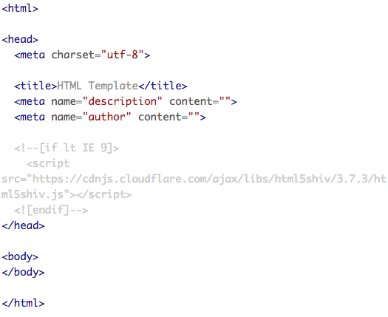
HTML

Slide 12
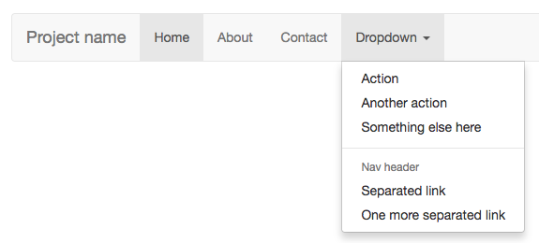
CSS
Notes:
https://getbootstrap.com/examples/navbar/

Slide 13
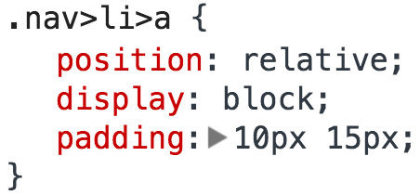
CSS

Slide 14
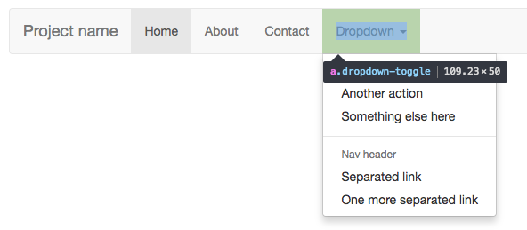
CSS

Slide 15
Javascript
JS is a dynamic programming language that can bring interactivity to websites (and other things).
Note: It’s not actually a subset of Java (it comes from ECMAScript standard, still called this sometimes (e.g. ES 6 is next)).
Also, it’s everywhere.

Slide 16
So what can you do with it?
Well, pretty much anything. OK, maybe not anything, … but close.
A few examples: Responses to when buttons are pressed or when data has been entered on forms, animations, games, dynamic styling,
… and so much more.

Slide 17
The NPM repository has 228K different packages, from webservers to package managers to “yo: CLI tool for running Yeoman generators” (npmjs.org)
Combined with chromium core, can even build cross-platform desktop apps!

Slide 18
A brief history of JS

Slide 19
Some of the features of JS
Variables
Conditionals
Functions
Arrays
Objects

Slide 20
Variables
The containers for data. Think of them as symbolic names for values. They are also the foundation for all other data structures in JS.
var number = 7;

Slide 21
Hey Python programmers: Remember to declare those variables. You’ll want to use the var keyword. (What happens if you don’t?)

Slide 22
Oh, and don’t forget the semicolon!
var number = 7;

Slide 23
Let’s talk variable scope:
Global
Local
(Primarily functional scope) (This is different than Python)

Slide 24
Functions
A procedure – a set of statements that performs a task or calculates a value. In short, a chunk of code that does things.
var calculateGratuity = function(bill){
var that = this;
return bill * 0.2;
};

Slide 25
In the previous: we stored a function in a variable. It didn’t have a name, so it is anonymous.
This is acceptable because functions in javascript are first-class objects (and we can manipulate them (cascades, currying, memoization)).

Slide 26
Arrays
A sequence of values in a single variable.
(Think list in Python.)
var scores = [0.68,0.77,.0.90];
var fruit =[“apple”, “orange”, “kiwi”];

Slide 27
Objects
A more complex type of variable. It contains properties and values, much like objects in the real world.
var fruit = {
kind: “apple”,
color: “red”,
quantity: 12,
tasty: true,
};

Slide 28
Remember to keep code readable
Inlining and comments do matter!

Slide 29
JSON
A way to organize data as objects that’s easy for you to read and for machines to parse and generate.
You will encounter this at some point using D3 … and it will be useful.

Slide 30
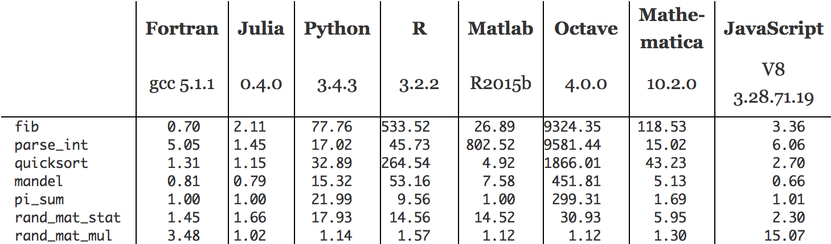
Node.js: run JS on the server.
Scalable network applications, yep.
Concurrency, yep.
Speed, yep.
Efficiency, yep. (thanks Google! #V8)
http://julialang.org/

Slide 31
Let’s load a web page
…in slow motion!

Slide 36
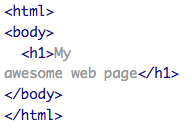

Slide 37
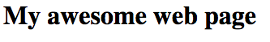

Slide 38
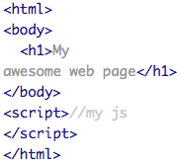

Slide 40
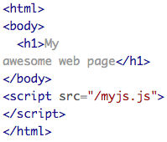

Slide 41
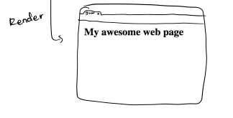

Slide 45


